Slide 1
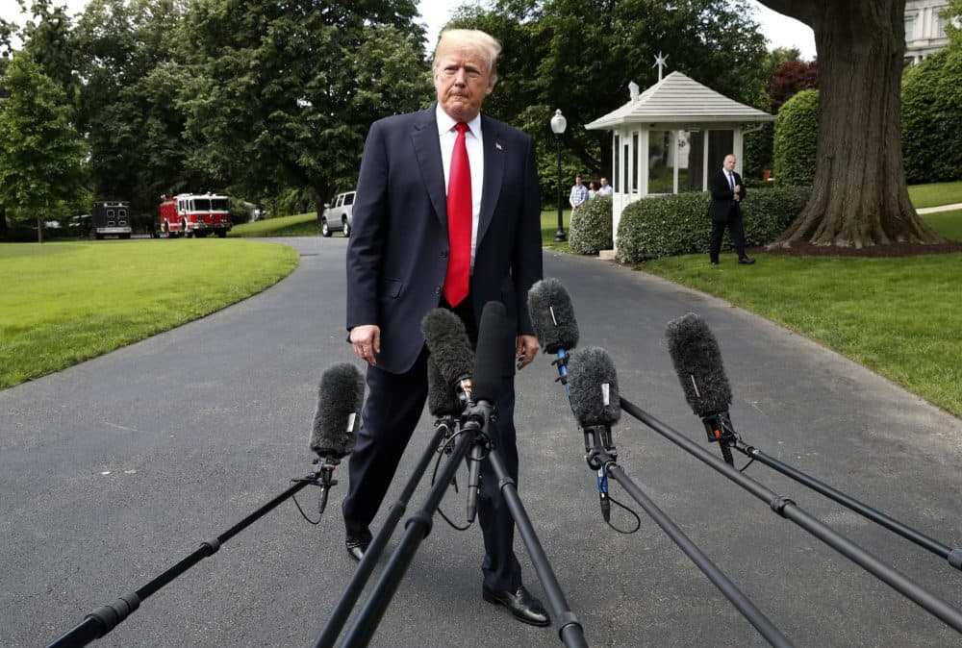
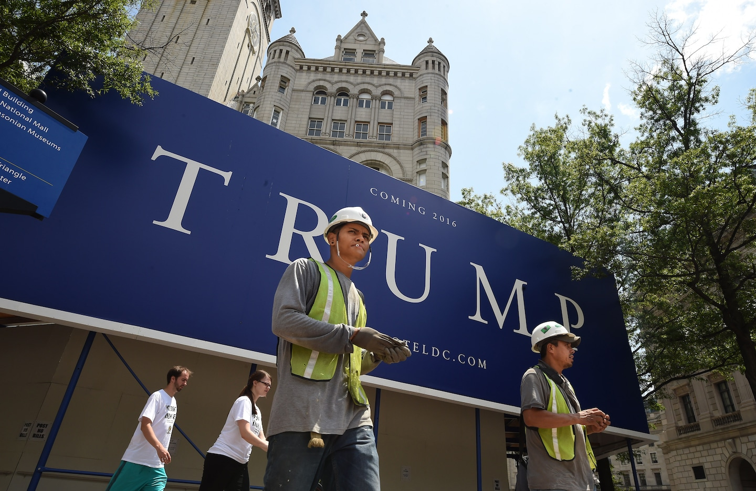
Please keep all images and text within the orange guides
Multimodal Fake News Detection on Social Media
An evidence-informed MSc project grounded in systematic literature review findings.
Background & Motivation
Dataset Overview & Preprocessing Pipeline
Methods outlook & contribution
Why multimodal?
Misinformation on social platforms often appears as posts with both text and images. Text-only detectors miss visual cues; image-only models ignore claims and context. This work asks whether joint use of text and image can support more robust detection than single-modality baselines, in line with gaps noted in the literature (controlled fusion comparisons, cost reporting, practical evaluation).
Sources
FakeNewsNet (e.g. PolitiFact / GossipCop): news articles with crawled text and images.
Fakeddit (Reddit): multimodal posts with metadata and image URLs.
High-level processing pipeline
Acquire — crawl / download sources (01–02).
Unify — single tabular schema (04): fakenews.tsv.
Cohort — stratified multimodal plan (05); download images (06); optional log dedupe (07).
Quality gate — heuristic image validity score (08); merge into table (09–10).
Gated export — training-facing subset fake_news_final.tsv (11, score threshold e.g. ≥75).
Current status
Gated multimodal export: ≈49k rows in fake_news_final.tsv (check splits/labels in notebook).
Reproducible Python pipeline + EDA / QA notebook for profiling.
Planned modelling (high level)
Unimodal baselines (e.g. transformer text encoder; CNN/ViT-style image encoder).
Multimodal fusion variants for RQ2; ablations for RQ3.
Evaluation: accuracy / F1, efficiency, error analysis; cross-dataset generalisation where feasible.
Insert your image here
Insert your image here
FAKE:“Trump Labels News Media ‘Enemy Of The American People’”
FakeNewsNet / GossipCop sample_id: fnn:gossipcop:fake:gossipcop-4373322193
REAL: “At Trump hotel site, immigrant workers wary”
FakeNewsNet / PolitiFact sample_id: fnn:politifact:real:politifact13310
Project Aim & Research Questions
Next Steps & Expected Contribution
A clear, reproducible data path from raw sources to a gated multimodal cohort.
Empirical comparison of fusion strategies and modality combinations, with honest limits (heuristic image QC, platform shift, etc.).
.
RQ1: Transfer learning vs traditional ML — effectiveness and computational cost.
RQ2: Fusion mechanisms (e.g. early vs late vs attention-based) under comparable settings.
RQ3: Multimodal vs unimodal gains across content types.
Scope: Text + image only; video/audio out of scope.
text text text text text text text text text text text text text text.
Next steps
Baselines: text-only and image-only models on the gated subset; then multimodal fusion comparisons (RQ2–RQ3).
Report metrics + runtime (RQ1).
Gradio proof-of-concept for interactive demo.
Mark Phillips

